Slide 1
Exploratory Data Analysis On Global Terrorism Attack

Slide 2
Introduction
The Global Terrorism Database (GTD) is an open-source database including information on terrorist attacks around the world from 1970 through 2017. The GTD includes systematic data on domestic as well as international terrorist incidents that have occurred during this time period and now includes more than 180,000 attacks. The database is maintained by researchers at the National Consortium for the Study of Terrorism and Responses to Terrorism (START), headquartered at the University of Maryland. In this project we are going to analyze the Global Terrorism Data in order to find out valuable insights.

Slide 3
Project Objective
This project provides an interactive visualization platform of the global terrorism attacks, to better support the researchers with deeper understandings of the patterns and regularities of the current world terrorism conflicts. This system seeks and presents potential correlations, clustering performances and feature rankings of different countries and parties, associated with types of attacks and casualties.

Slide 4
Modules and Libraries
Pandas :- Pandas is used to analyze data. It has functions for analyzing, cleaning, exploring, and manipulating data.
Matplotlib :- Matplotlib is a graph plotting library in python that serves as a visualization utility. Most of the Matplotlib utilities lies under the pyplot submodule.
Numpy :- NumPy is a Python library used for working with arrays. It also has functions for working in domain of linear algebra, fourier transform, and matrices.
Scipy :- This provides more utility functions for optimization, stats and signal processing. Like NumPy, SciPy is open source so we can use it freely.
Plotly :- The plotly is an interactive, open-source plotting library that supports over 40 unique chart types covering a wide range of statistical, financial, geographic, scientific, and 3-dimensional use-cases.
Seaborn :- Seaborn is a library that uses Matplotlib underneath to plot graphs. It will be used to visualize random distributions.
Datetime :- The datetime module supplies classes for manipulating dates and times. While date and time arithmetic is supported, the focus of the implementation is on efficient attribute extraction for output formatting and manipulation.

Slide 5
Attributes in Dataset
Column | Data Type
Year | Integer
month | Integer
day | Integer
country | Object
region | Object
state | Object
city | Object
latitude | Float
longitude | Float

Slide 6
success | Integer
attack_type | Object
target_type | Object
gang_name | Object
weapon_type | Object
no_of_kills | Float
wounds | Float

Slide 7
Handling the NaN Values
Missing Data can occur when no information is provided for one or more items or for a whole unit. Missing Data is a very big problem in a real-life scenarios. Missing Data can also refer to as NA(Not Available) or NaN (Not a Number) values in pandas. In DataFrame sometimes many datasets simply arrive with missing data, either because it exists and was not collected or it never existed.
Columns which I have handles the NaN Values :-
The state column has 421 NaN values.
The city column has 434 NaN values.
The no_of_kills column has 10313 NaN values.
The wounds column has 16311 NaN values.
The latitude column has 4556 NaN values.
The longitude column has 4557 NaN values.

Slide 8
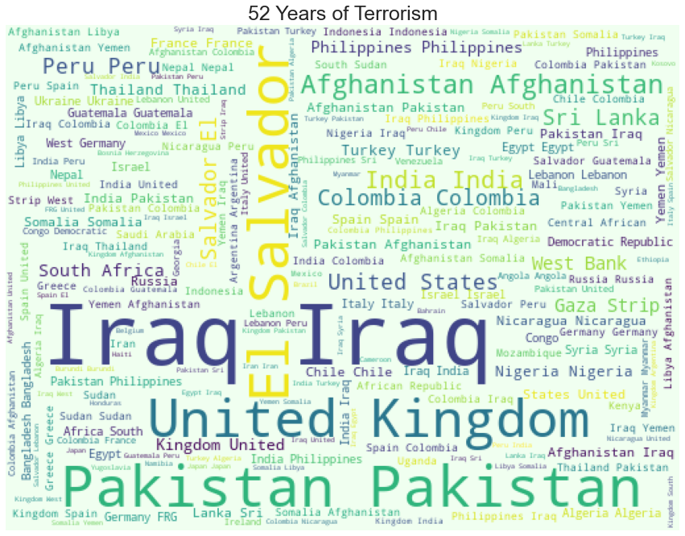
The Word Cloud obtained by all countries
Observation :- As our word cloud shows that the frequency of the country Iraq is the most.

Slide 9
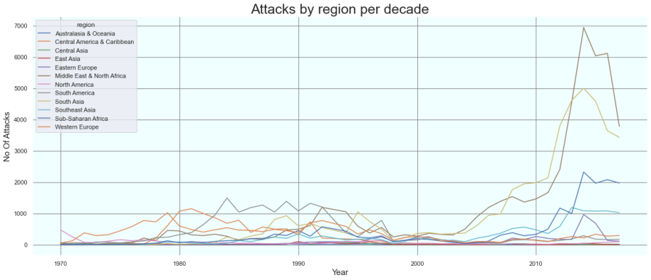
Total number of attacks in every year by region
Observation :- By looking at the graph we analyzed that attacks were taking place at nearly constant rate across the world for 4 decades, but in 2010 clearly a huge spike came in Middle East and South Asia region.

Slide 10
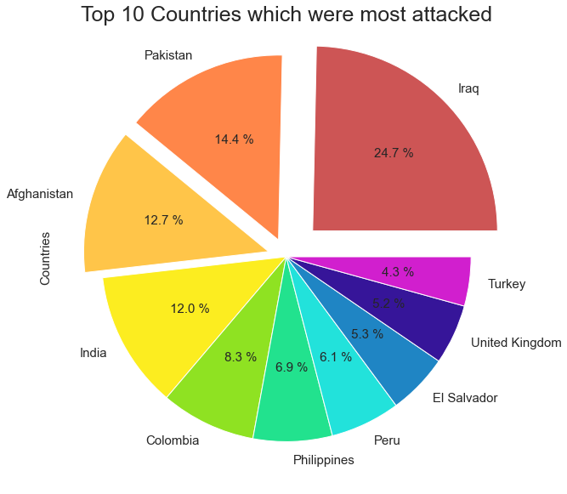
Top 10 Countries which were most attacked
Observation :- Iraq was the most attacked country across the world with 24636 attacks, followed by Pakistan, Afghanistan and India.

Slide 11
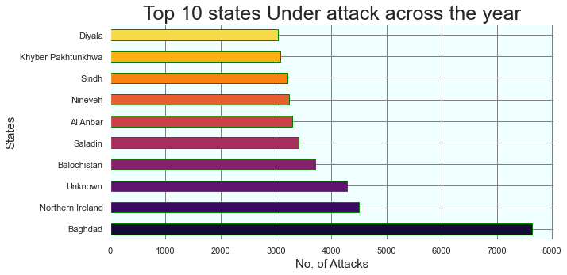
Top 10 States under attack across the year
Observation:- Baghdad state which is the capital of Iraq is the most attacked in the world with 7645 attacks followed by Northern Ireland.

Slide 12
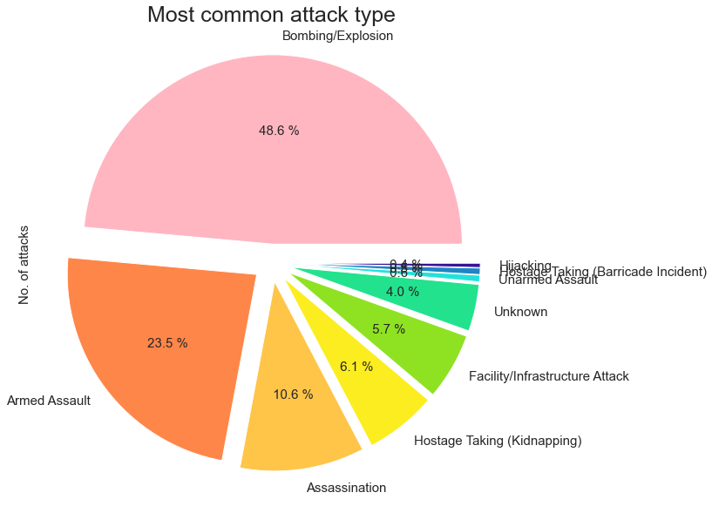
Most common attack type among the terrorist groups
Observation :- Bombing and Explosions are the most preferred attack type used by the terrorists. Around 50% of the terrorist groups are using this attack type, followed by Armed Assault and Assassination.

Slide 13
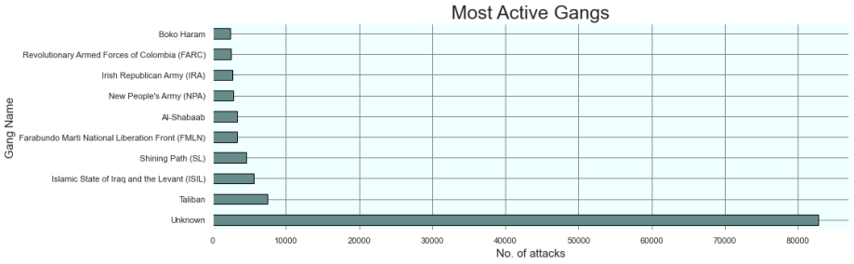
Most Active Gangs across the years
Observation :- By this graph we can say that Taliban is the most active terror organization. Also, more than half of the attacks which are done by unknown terrorist groups which seems to be a huge concern.

Slide 14
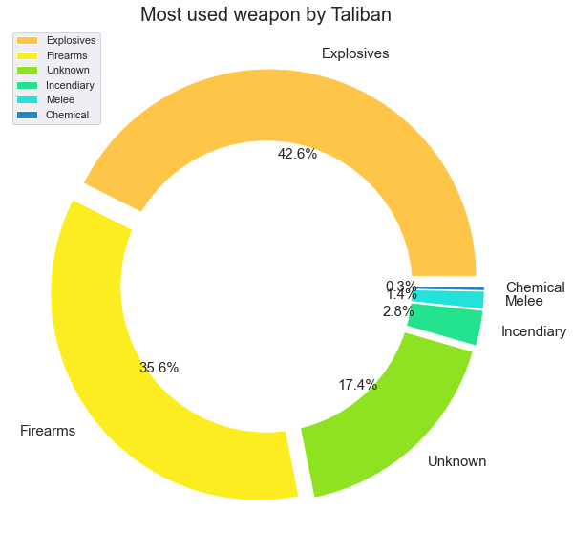
Attack type is used by the deadliest gang 'Taliban'
Observation :- It is clearly visible from the above donut chart that Firearms and Explosives are the most used attack types used by the deadliest gang Taliban. so, there should be stricter rules to prevent the movement of firearms and explosives into and from the countries.

Slide 15
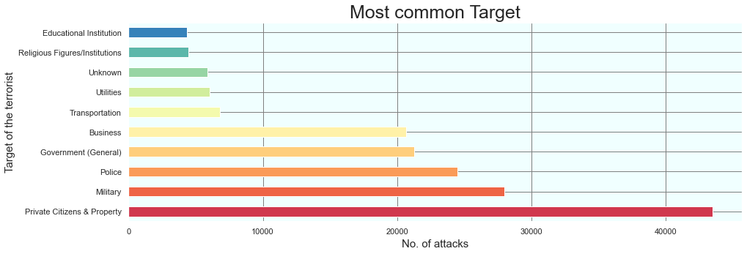
Most common target of the terrorists
Observation :- 'Private Citizens and Property' are the constant target of the terrorist groups, tighter security and surveillance should be provided, especially in densely populated regions.

Slide 16
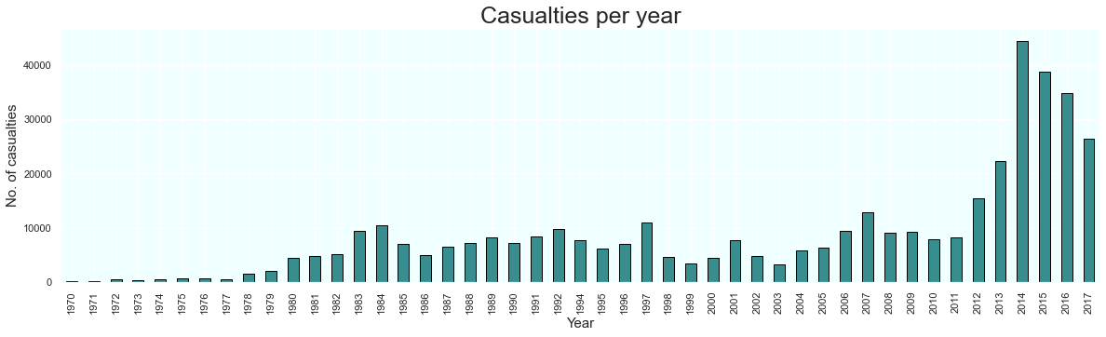
Most number of casualties per year
Observation :- As clearly visible from the above graph, the year 2014 had the most number of casualties, with the most number of attacks followed by year 2015 and 2016.

Slide 17
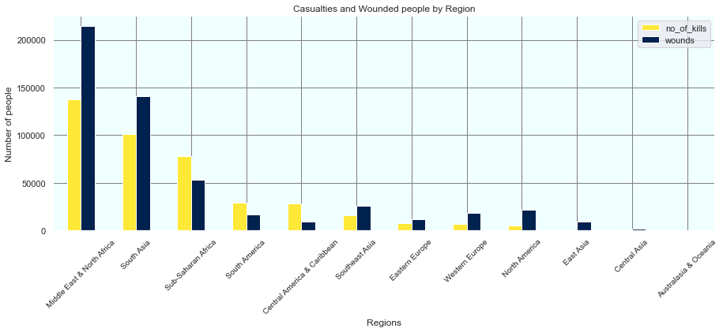
Comparing the number of casualties and wounded people across every region
Observation :- We can observe that there are more wounded people than casualties in all the regions except 'Sub-Saharan Africa', 'South America' and 'Central America & Caribbean', which have more casualties than wounded people.

Slide 18
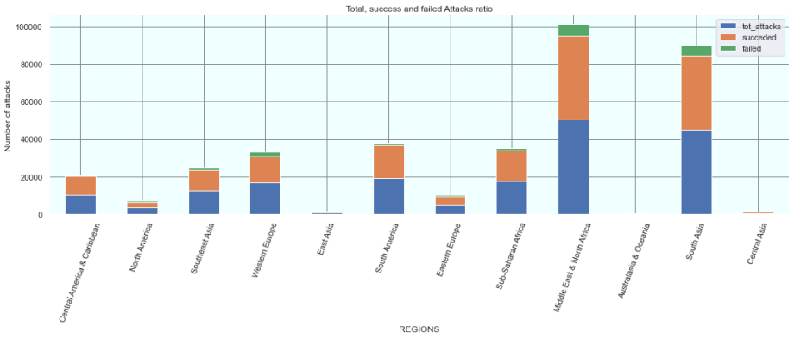
Relation between total, successful and failures attacks
Observation :- The graph shows that the success rate of attacks is very high in all regions. Also, The highest number of attacks happened in the Middle East and North Africa followed by South Asia, whereas Central Asia and East Asia are the least attacked. Although in the Middle East and North Africa attacks that failed are high, the ratio of the success and failed attacks remains to be the same for other regions.

Slide 19
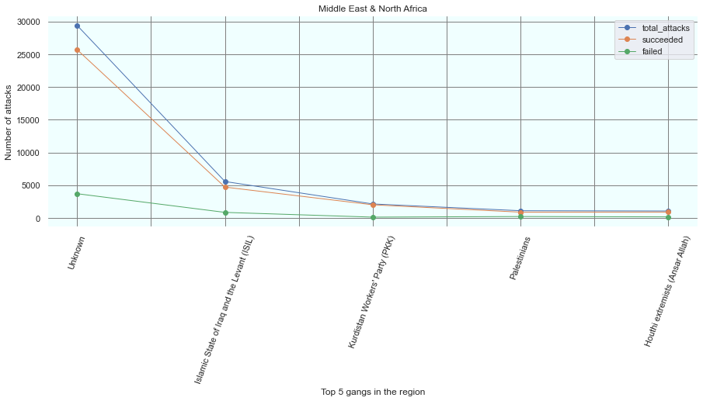
Comparing the success and failed attempts of the region which are most affected by dangerous gangs
Observation :- The above graph indicates that unknown groups are responsible for most of the attacks and also success ratio seems to be very high as well.

Slide 20
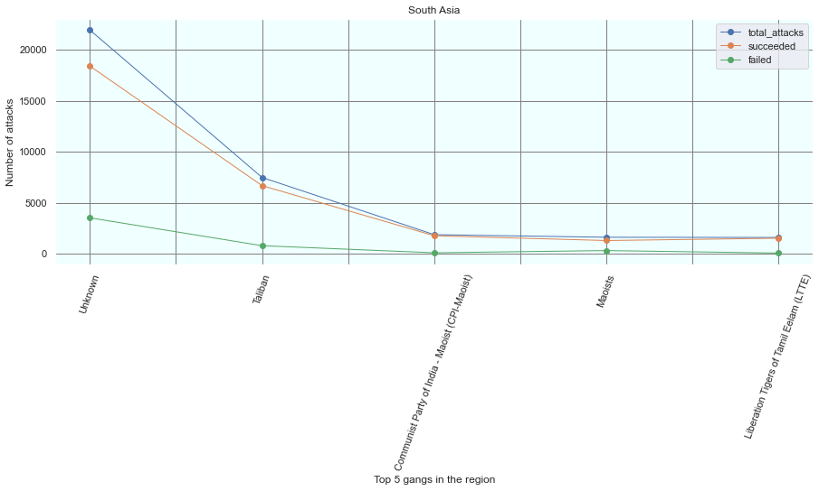
Observation :- South Asia which is the second most affected region also has unknown gangs active and highly successful followed by the Taliban, which also has a good success rate. Moreover, we found that no same group comes under the top 5 attackers when we compare data of the two most affected regions.

Slide 21
Conclusion
The Year 2014 had the most number of terror attacks in the last decade. Approximately 17000 attacks in one year. This means that around 47 attacks were happening every single day during that year in multiple locations around the world.
The Middle East & North Africa were the top affected region. 28.04 % of all events and a staggering 36.47 % of total casualties have been exclusive from these regions.
Iraq has been the country with the highest number of attacks and 21.87% of all casualties have been from Iraq.
Baghdad has been the most attacked city in the world, 7 of the cities are from Iraq and 4 of the cities are from Pakistan.
Bombing/Explosion has been consistently the most popular method of attack over the last 5 decades with 47.7% of all attacks.

Slide 22
Taliban has gained much prominence since 2012 and is now responsible for the most number of terror attacks, and the most common attack type used by them are firearms and explosives. This has been the same for the most terrorist group.
Around 82000+ attacks were done by unknown groups of gangs, which is a major security concern.
Private Citizens and Property are the most attacked targets, followed by the Military, Police, Government, Transportation, etc.

Slide 23
Thank You!!

